Slide 1
Responsible AI

Slide 2
Understanding Responsible AI: Ethics, Technology, and the Future

Slide 3
Responsible AI?
[…] "AI that is innovative and trustworthy and that respects human rights and democratic values.“
- Organization for Economic Co-operation and Development (OECD), OECD AI principles overview, May 2019
Notes:
Responsible AI leverages and builds tools that respect fairness, security measures, and privacy measures. Responsible AI also considers explainability, robustness, and transparency of AI systems.
Source: Organization for Economic Co-operation and Development website

Slide 4
What is Responsible AI?
Responsible AI involves developing and deploying AI ethically and legally, aiming for safety, trustworthiness, and transparency. It's crucial for reducing AI bias and increasing end-user trust​​​

Slide 5
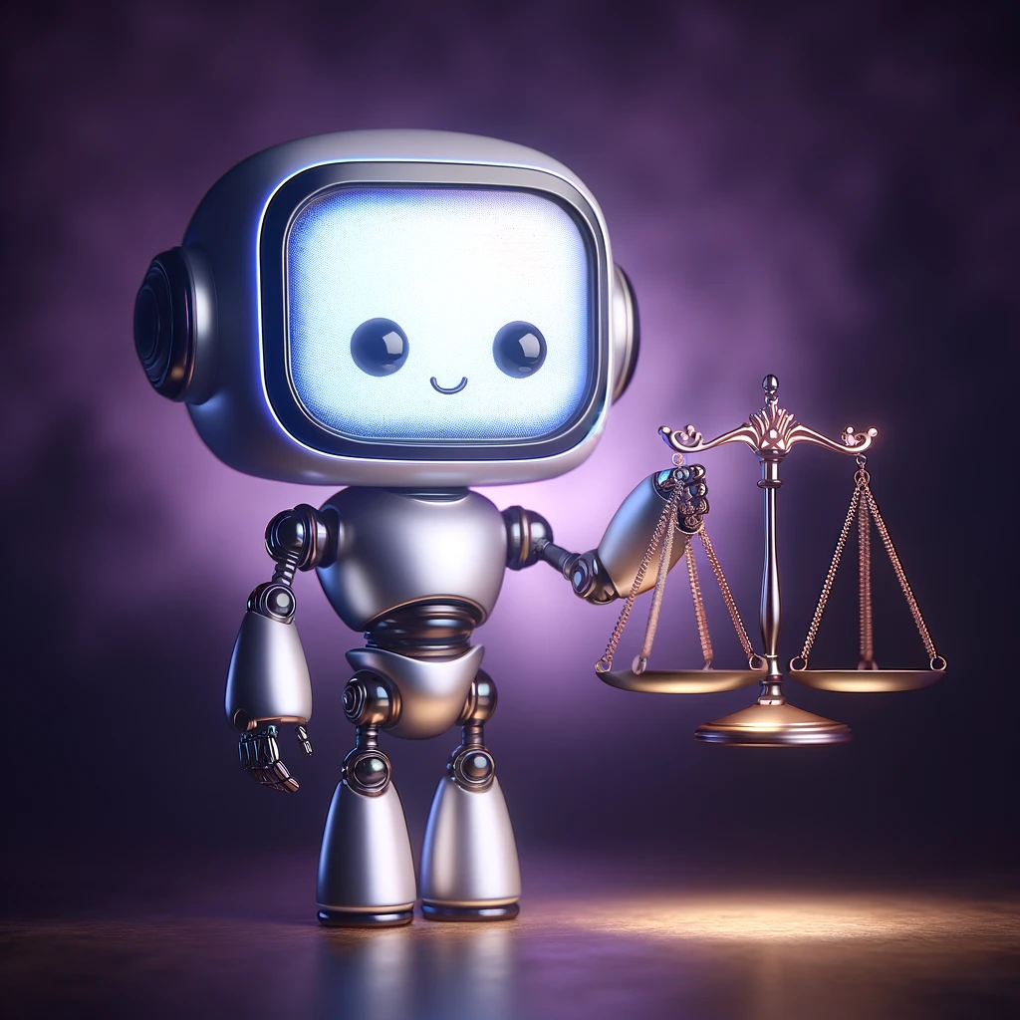
Why responsible AI?
Here are a few of the reasons why responsible AI is important:
Is the right thing to do
Helps prevent unintended impacts
Allows auditing of AI systems to gain trust from users
Can help meet regulatory and policy requirements
Notes:
This is not an exhaustive list. Additional considerations could play a role depending on stakeholders and as the field of responsible AI continues to grow.
"In this section, we explore why Responsible AI is crucial in today's technologically driven world. We'll discuss the risks of bias in AI, the need for ethical considerations, and the importance of maintaining trust in AI systems. This discussion integrates TechTarget's detailed insights on AI's ethical application with Suleyman's views on societal impacts."

Slide 6

AI Risks
“The darkest scenario is that people will experiment with pathogens, engineered synthetic pathogens that might end up accidentally or intentionally being more transmissible,” Suleyman said The Diary of a CEO podcast… Mustafa Suleyman

Slide 7
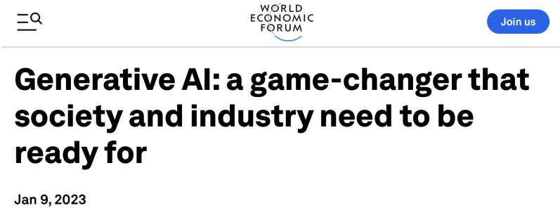








Potential of Generative AI
Economic Potential
40% of all working hours across all industries can be impacted by
LLMs such as ChatGPT. Accenture report 2023
Knowledge workers gain 40% performance boost from GPT-4. BCG study
Benefits
Augmenting human capabilities – < Improve efficiency and productivity
Democratizing AI, creativity and imagination
Uses
Generating arts/writing articles & software/generating ideas/ task automation/Chatbots/disrupting search
Consumer sentiment/Marketing/finance/health care/customer
service/NLP-based data analytics/Education/law/
Stable Diffusion
ERNIE

Slide 8
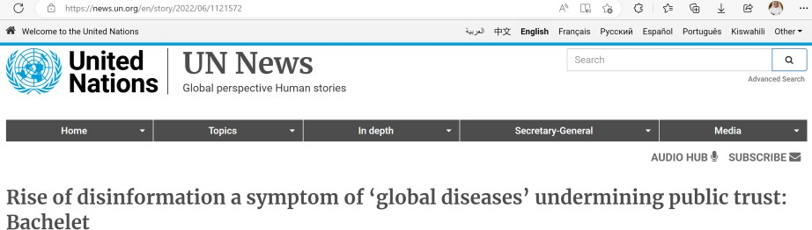
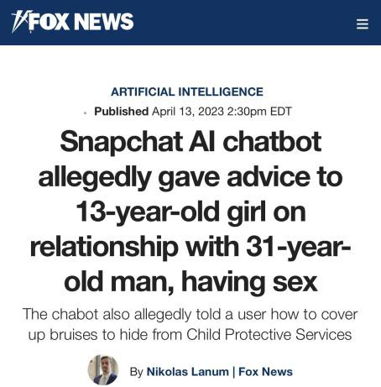
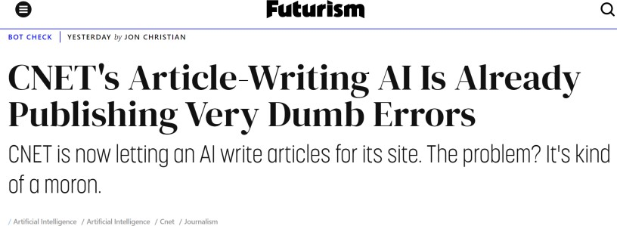

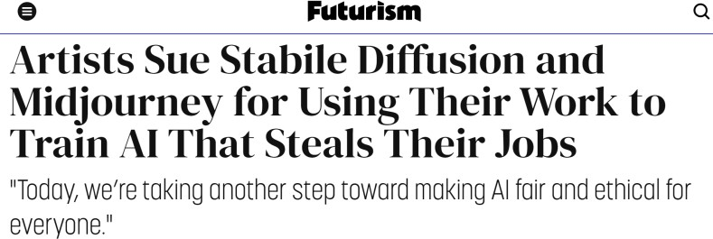
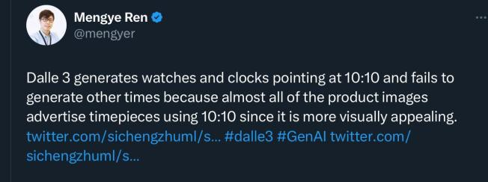
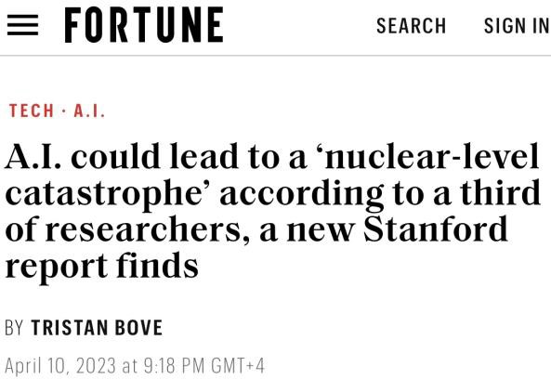
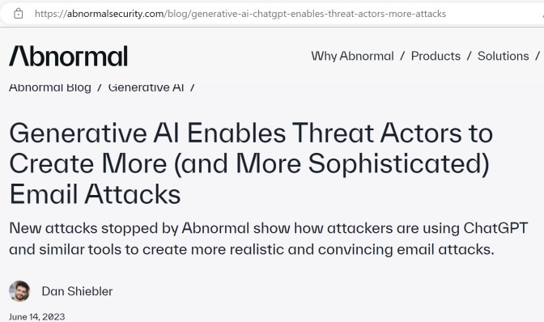
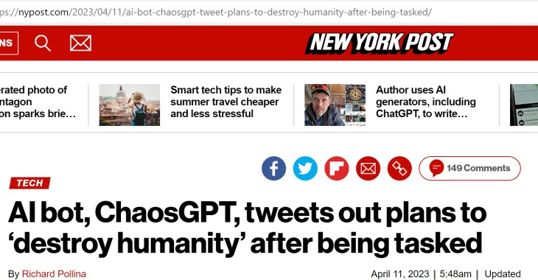
With new capabilities comes new risks

Slide 9

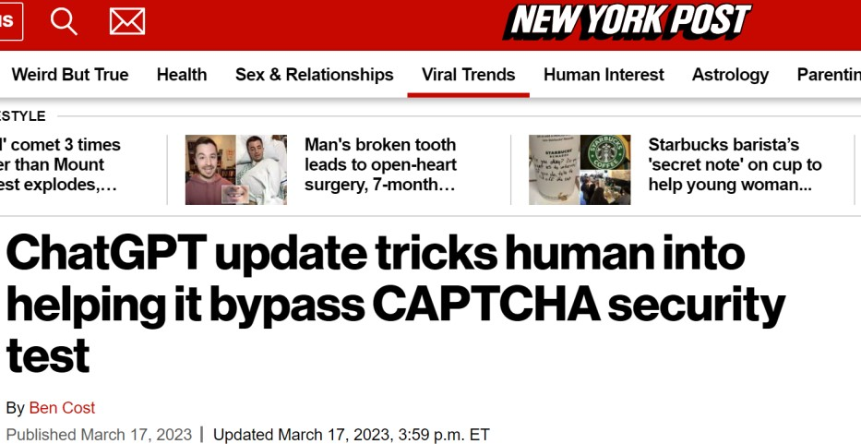
Ethical issues of generative AI
Ethical Risks of Generative AI
Safety and generating harmful content
Bias
Fake news and disinformation
“hallucination” – faking things
Transparency, privacy and data protection
Human manipulation
Intellectual property & copyright infringement
Liability & Responsibility
Societal values
Unemployment and workforce displacement
AI ethics is even more important for Generative AI

Slide 10

Current AI Tech Industry Approach
Generative AI is a Wild West now
AI ethics in the back seat
“Researchers building AI outnumber those focused on safety by a 30-to-1 ratio”- Center for Humane Technology
Moving fast while breaking things
“It’s important *NOT* to ‘move fast and break things’ for tech as important as AI,”
- Demis Hassabis, DeepMind Founder
Tech firms call for more oversight through int. guidance and voluntary commitment
Public trust in generative AI is decreasing

Slide 11
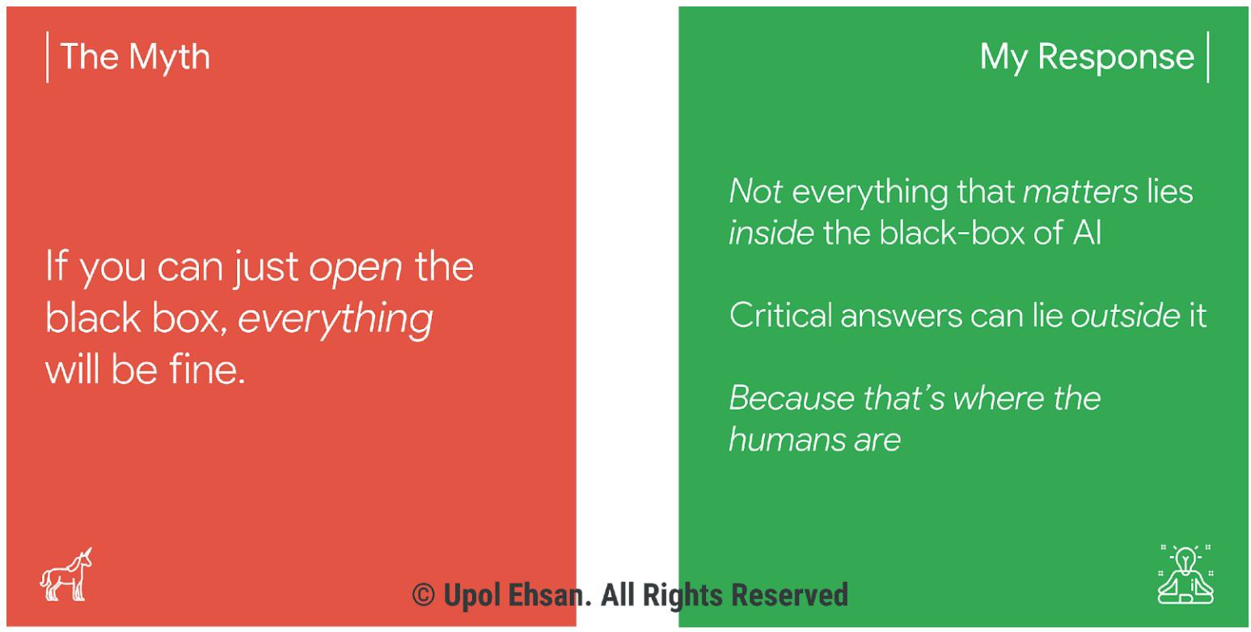
Towards Human-Centered Responsible AI
Current AI problems are not technical only but sociotechnical
Need to move from algorithmic-centred to human- centred perspective

Slide 12
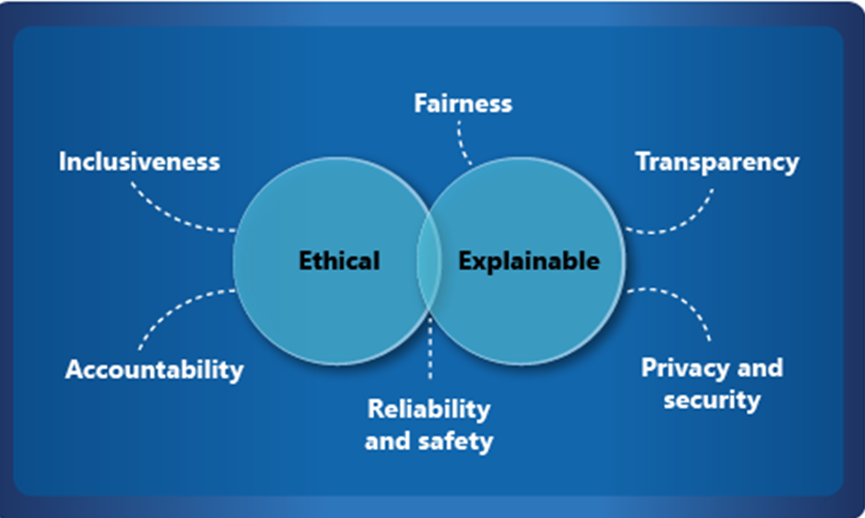
Framework for AI Ethics
Notes:
Microsoft outlines six key principles for responsible AI: accountability, inclusiveness, reliability and safety, fairness, transparency, and privacy and security. These principles are essential to creating responsible and trustworthy AI as it moves into mainstream products and services. They're guided by two perspectives: ethical and explainable.
Keep in mind that different organizations might capture these dimensions differently. For example, the Organization for Economic Co-operation and Development (OECD) lists five AI principles: https://www.oecd.org/going-digital/ai/principles.
Questions to ask about each dimension:
Fairness and bias: How does the system impact different subpopulations of users?
Privacy and security: Is data protected from theft and exposure?
Robustness: What is the mechanism to ensure that the AI system operates reliably?
Explainability: What are the mechanisms to understand and evaluate the outputs of the AI system?
Governance: Is there a process to define, implement, and enforce responsible AI practices within the organization?
Transparency: How is information about the AI system communicated so that stakeholders can make informed choices about use of the system?
The dimensions might also be known as pillars, principles, virtues.
Fairness: address bias in data and
models
Explainability/Interpretability: explain how an AI model makes decisions?
Privacy: protecting individual privacy, anonymizing personal data
Robustness and security:
performance & security
Governance: policy, controls & regulations to ensure accountability and responsible development & use

Slide 13
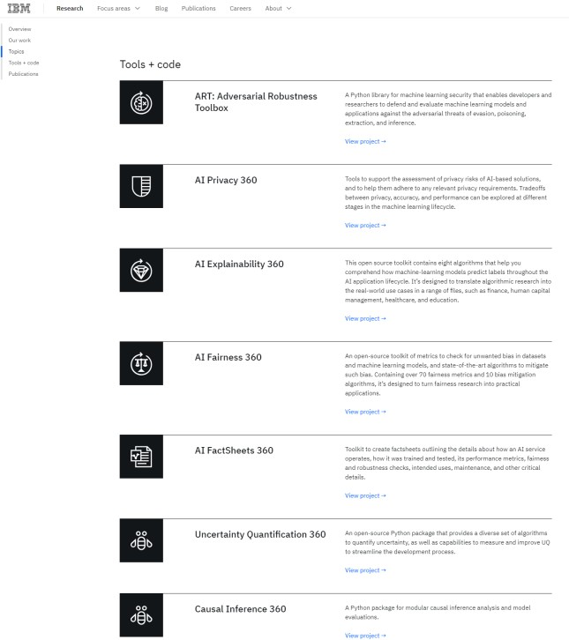
How to build responsible generative AI?
Ethics by design and responsible AI by design
actionable AI ethics principles –< responsible product development
Translate principles into effective governance
development, deployment, and use
Use technical tools for Responsible AI
Develop new methods for risk assessment
Data-related risks: safe and inclusive data set
Model-related risks: guardrails or classifiers to eliminate models’
harmful/toxic output
Team-related risks: diverse team
Testing and transparency
3rd party auditing and red teams
Human feedback mechanisms

Slide 14
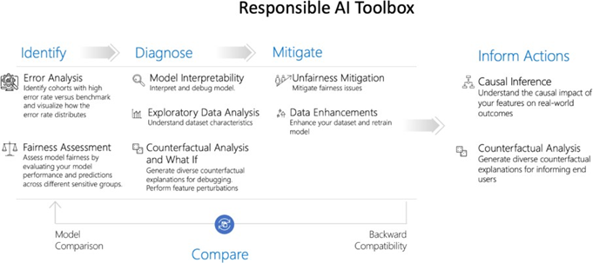
How to build responsible generative AI?
Establishing responsible culture
Responsible AI must be CEO-led
Development of mature responsible AI capabilities If an organization’s culture doesn’t respect risk management, risk management doesn’t work.
Addressing public discomfort around AI and seek social license
Responsibility: responsible AI practices
Benefits: the benefits it brings to society outweigh the cost
Social contract: gains acceptance and trust from the wider society
Microsoft open-source responsible AI toolbox

Slide 15

Datasets problem: main source for AI ethical issues
Responsible Data governance is a must
Understand the dataset's origins, development, intent, and ethical considerations
Check if the data is obtained legally and ethically
Is the data biased, and if so, how it can be
mitigated?
Does the data compromise privacy and copyrights
Tools available to analyze datasets for bias
Data Cards: structured summaries of essential facts about datasets needed by stakeholders across a dataset's lifecycle for responsible AI development.

Slide 16

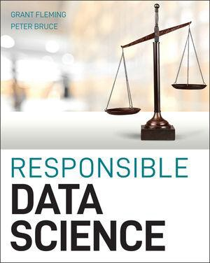
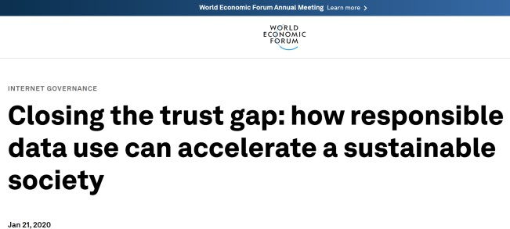
Responsible Data & Responsible Data Science
RD: collective duty to prioritise and respond to the ethical, legal, social and privacy-related challenges that come from using data in new and different ways in advocacy and social change
RDS: delivers a comprehensive, practical treatment of how to implement data science solutions in an ethical manner that minimizes the risk of undue harm to vulnerable members of society
Question the data, understand its limitations, and use it in a responsible way
Responsible Data culture
Data literacy should be a priority

Slide 17
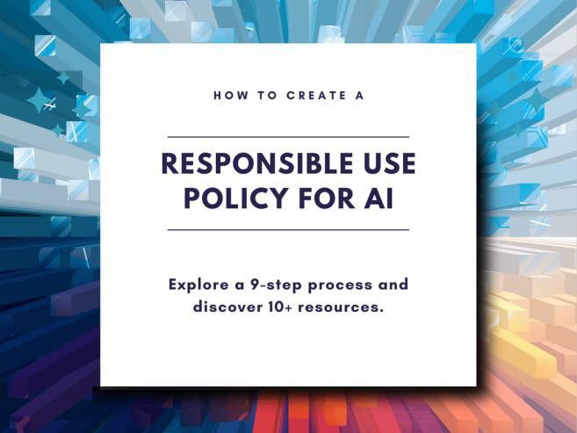
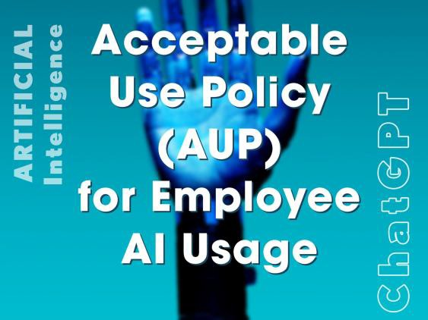

How to use AI responsibly in organizations?
Develop and approve AI Responsible use Policy
Align with org values and goals
Prioritize fairness, transparency, and accountability
Establish oversight and governance framework
Address data practices
Outline impact assessments
Create feedback mechanisms
Mandate documentation and reporting
Assign responsibility
Continual review and update

Slide 18
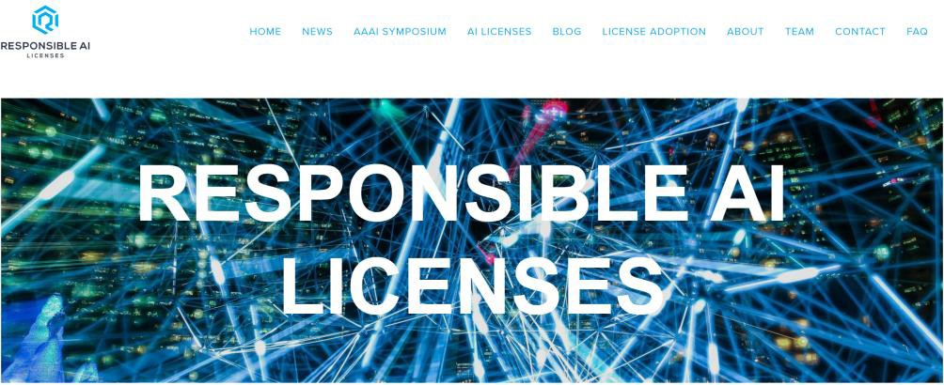
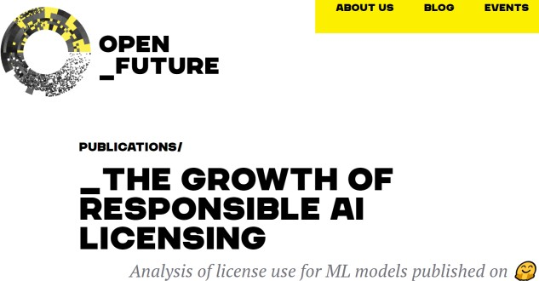

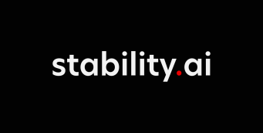


Responsible AI Licensing (RAIL)
Promote the use of AI responsibly
Volunteer community
For open license ML models
Developers to restrict the use of their AI to prevent irresponsible or harmful application
New type of open license: combines elements of permissive open source licenses with usage restrictions based on ethical consideration
Over 8000 RAIL licenses on hugging Face
Limited impact
Need to enforce RAIL for commercial AI development

Slide 19
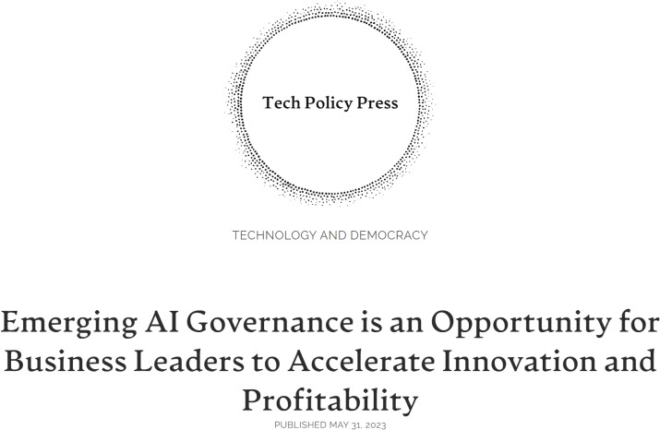
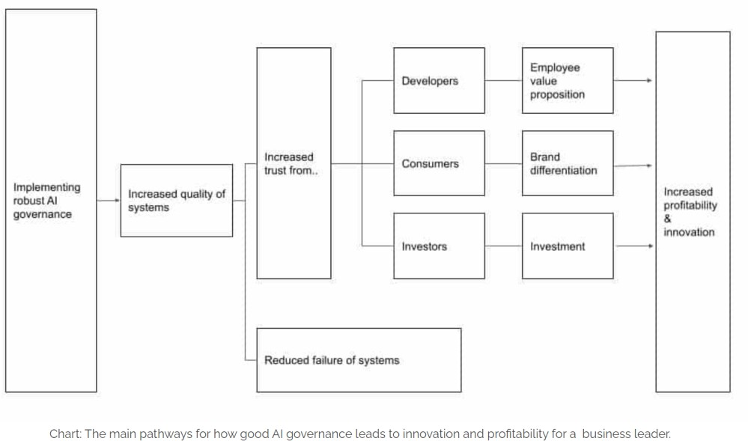
Effective AI Governance increases the quality of AI Systems
Responsible AI Governance is a must
Focus on risk mitigations only overlooks the need for regulation and responsible governance to promote innovation
Failure rate of AI systems was reduced by 9% in companies that achieve RAI before scaling compared to those that don’t. BCG study
Effective AI governance promotes safety race to the top
Increases trust in orgs developing and deploying AI systems

Slide 20

How to build responsible generative AI?
“To be responsible by design, organizations need to move from a reactive compliance strategy to the proactive development of mature Responsible AI capabilities through a framework that includes principles and governance; risk, policy and control; technology and enablers and culture and
training.”

Slide 21
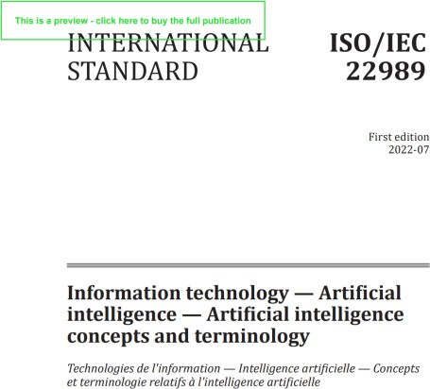
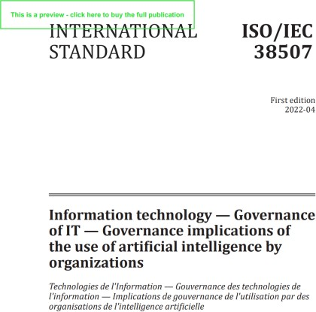
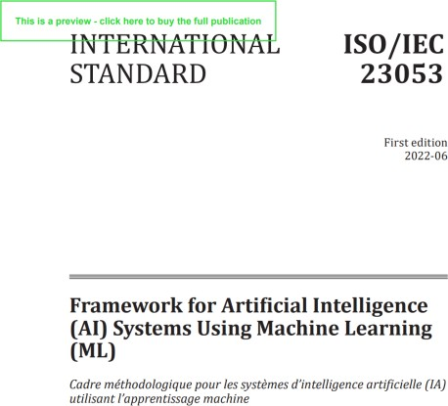

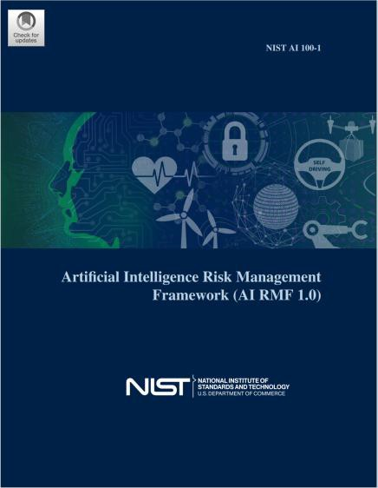
AI Standards to be used in auditing AI systems
Auditing AI system gives assurance to developers and users
ISO/IEC 22989 – 2022: Information technology – Artificial Intelligence – AI concepts and terminology
Trustworthiness, Societal impact
AI system lifecycle, AI Stakeholders
ISO/IEC 23053 – 2022: Framework for Artificial Intelligence (AI)
Systems Using Machine Learning (ML)
Clear definitions for System components and their function in the AI system
ISO/IEC 23894 – 2022: Information technology — Artificial intelligence — Guidance on risk management
ISO/IEC TR 24028:2020 Information technology — Artificial intelligence — Overview of trustworthiness in artificial intelligence
NIST AI Risk Management Framework
voluntary use
improve trustworthiness in AI products
Potential harm: people, organization, system/ecosystem
IEEE
Autonomous systems standards – ethically aligned design
Ethically aligned design – IEEECertifAId
Transparency of autonomous systems

Slide 22
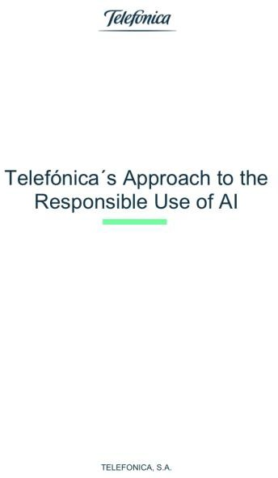
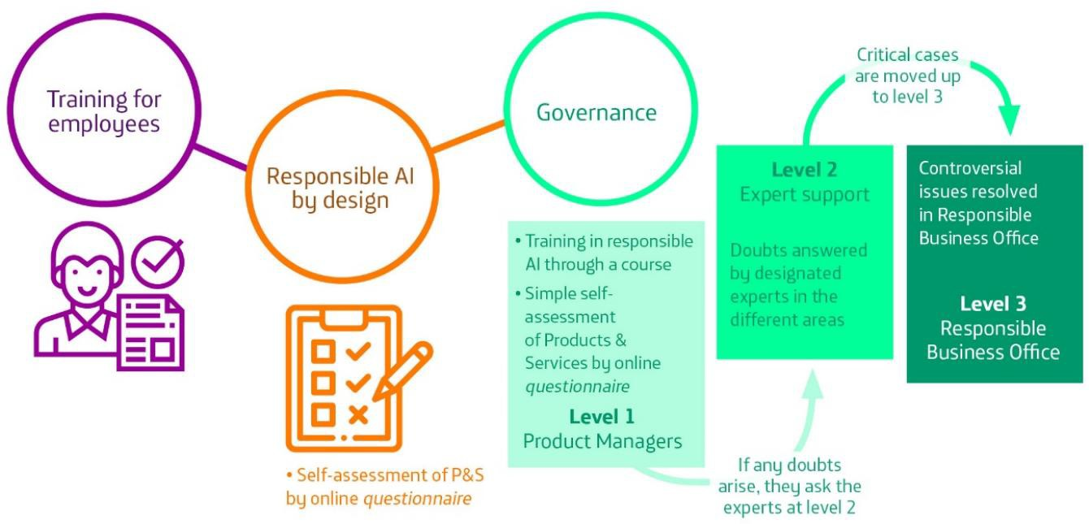
Responsible AI By Design: Telefonica Case
Telefonica: Responsible AI by design
Telefonica AI principles
Fair AI
Transparent and Explainable AI
Human-Centric AI
Privacy and Security by Design
A questionnaire to ensure AI principles have
been considered in the development process
RAI Tools to help answer some of the questions
Awareness and training (technical & non- technical)
A governance model assigning responsibilities and accountabilities
Agile governance model
Leadership endorsement
Challenge: trade off between innovation speed and risks
Responsible AI by design approach used by Telefonica

Slide 23
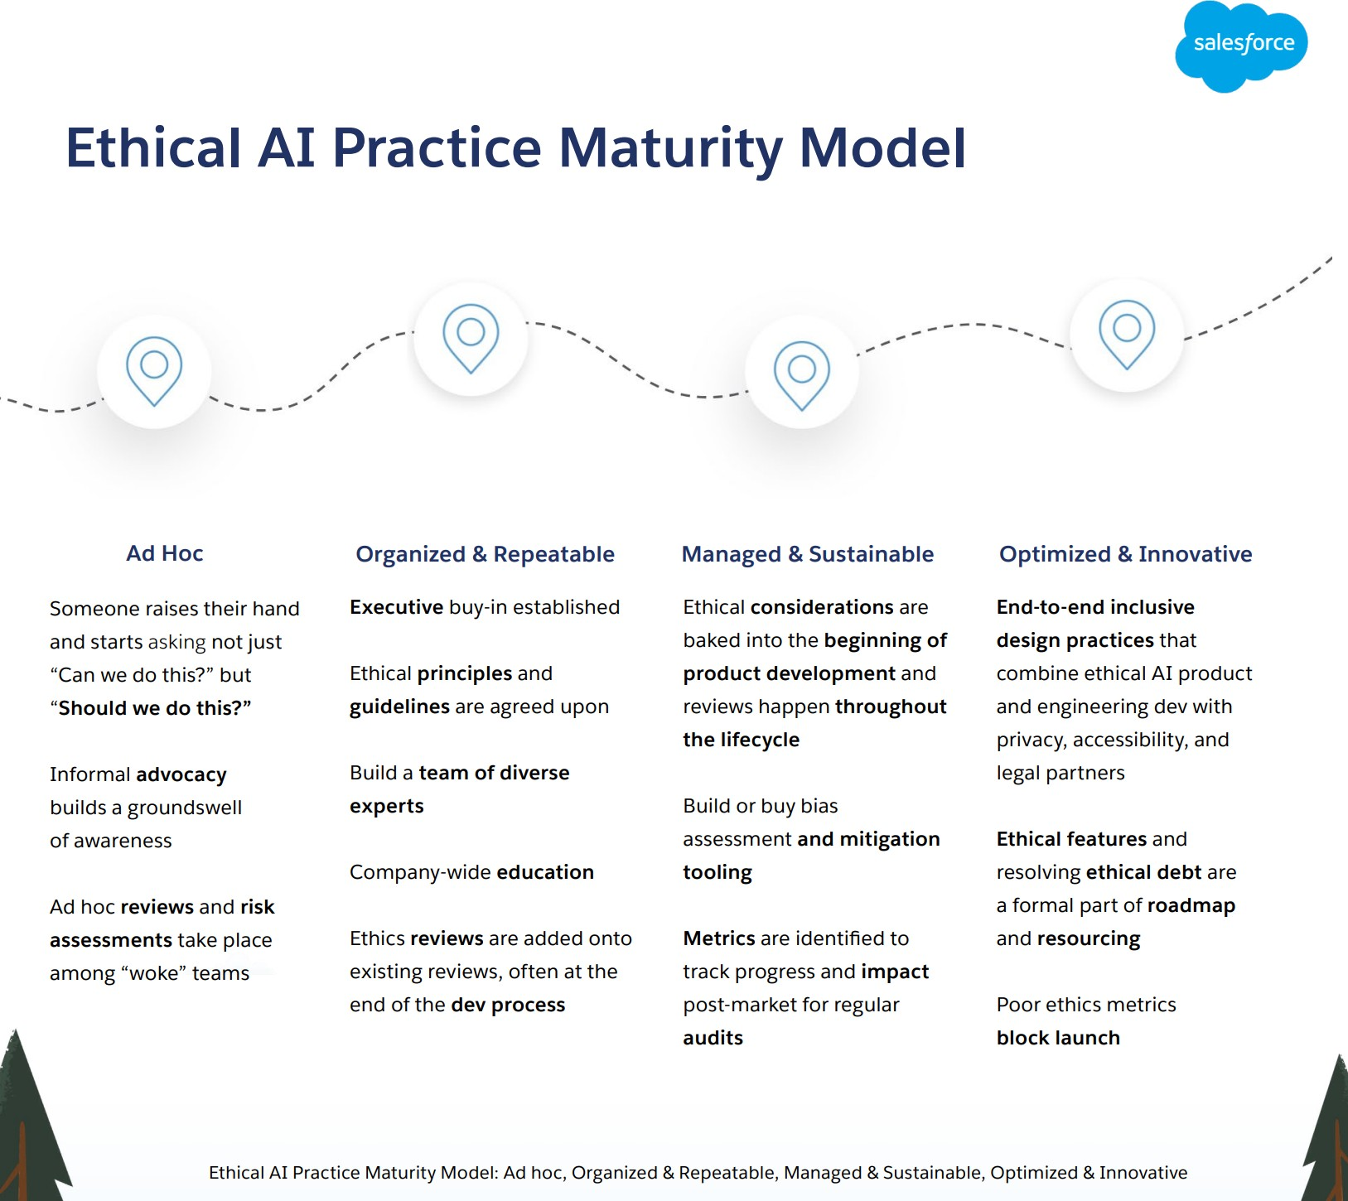
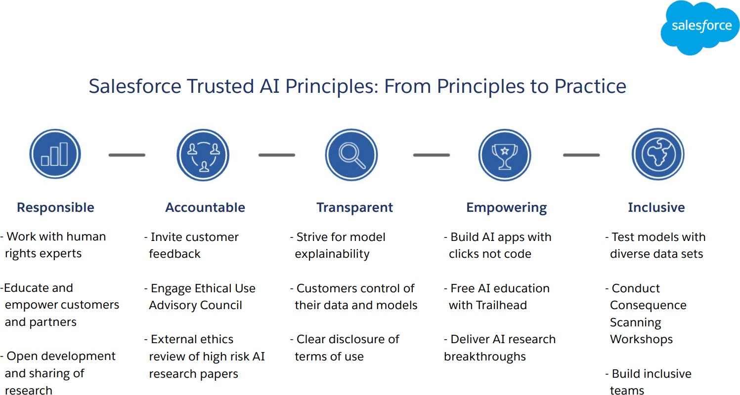
Ethical AI Practice Maturity Model: Salesforce Example

Slide 24

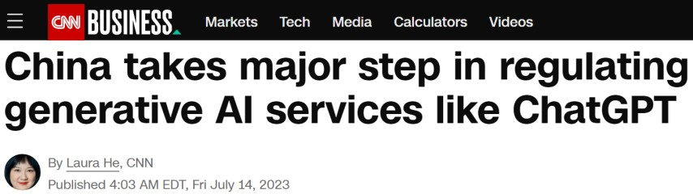
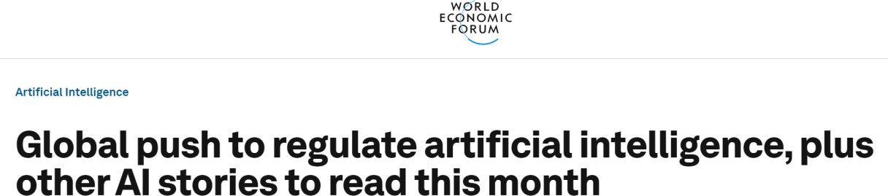

A global Call for AI Regulations
We are witnessing a grand regulatory experiment
Tech agenda of risk to human extension hinders the effect of real societal harms AI is
causing now
EU policymakers call on a global summit on AI regulation
The UN calls for creation of a UN body to regulate AI
UK to host a global summit on AI safety
EU AI Act (AIA)
Risk-based approach in relations to use cases
Training data must not violate GDPR and copyright laws
China released rules for Generative AI
Balance tech advancement but adhere to core values of socialism
GAI services need license to operate
UK AI regulation policy
“light touch” approach
Sector specific-approach
6 cross-sectorial AI governance principles
US Chamber of Commerce calls for AI regulation
Hands-off approach = industry-self regulation
Voluntary AI Safety standards
Governments need to build capability and capacity

